Slide 1
Secret Quantum Hitler
From Capital Q team

Slide 2
Review of main changes
Every fascist player has equal right to become a Hitler in the game
Chancellor is elected by qubits
Qubits determine which policy will be drawn from the deck
Concept of quantum bullet

Slide 3
Hitler role probability
Original: Hitler’s card is given to the player; they know they’re Hitler
Quantum: Initial Hitler role is a superposition among all the fascists; the more person votes for the fascists policies, the higher chance to measure this person as the Hitler

Slide 4
Chancellor’s election
Original: Players use yes/no ballots; majority wins
Quantum: Players influence decision qubit, but only measurement determines election result. For instance, we could have 0.7 candidate win chance (0.7 chance to measure 1), but the election fails (due to measuring 0)

Slide 5
Policy cards
Original: The President draws three policy cards (from a fixed deck), discards one, and passes two to the Chancellor, who then enacts one.
Quantum: Initial chance of drawing liberal policy is 6/17. President and chancellor can increase or decrease the chance of getting liberal policy card. If one of them increases the chance of getting fascist policy, they become likely to be a Hitler (decision influences the Hitler state)

Slide 6
Quantum bullet
Original: Once enough fascist policies are enacted, the President may choose and definitively eliminate a player of their choice.
Quantum: President chooses who to shoot, but it makes only 0.8 chance of that person being shot. So, anyone can get the bullet, even the president themselves

Slide 7
Some Highlights

Slide 8
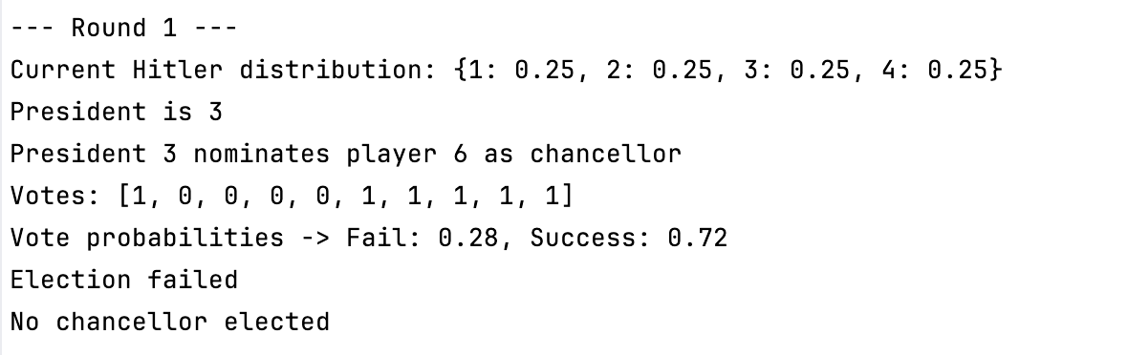
Election fail with high success chance

Slide 9
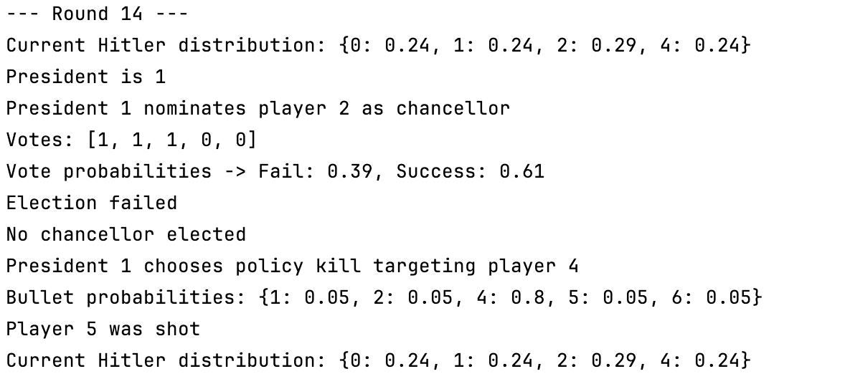
Quantum bullet effect

Slide 10

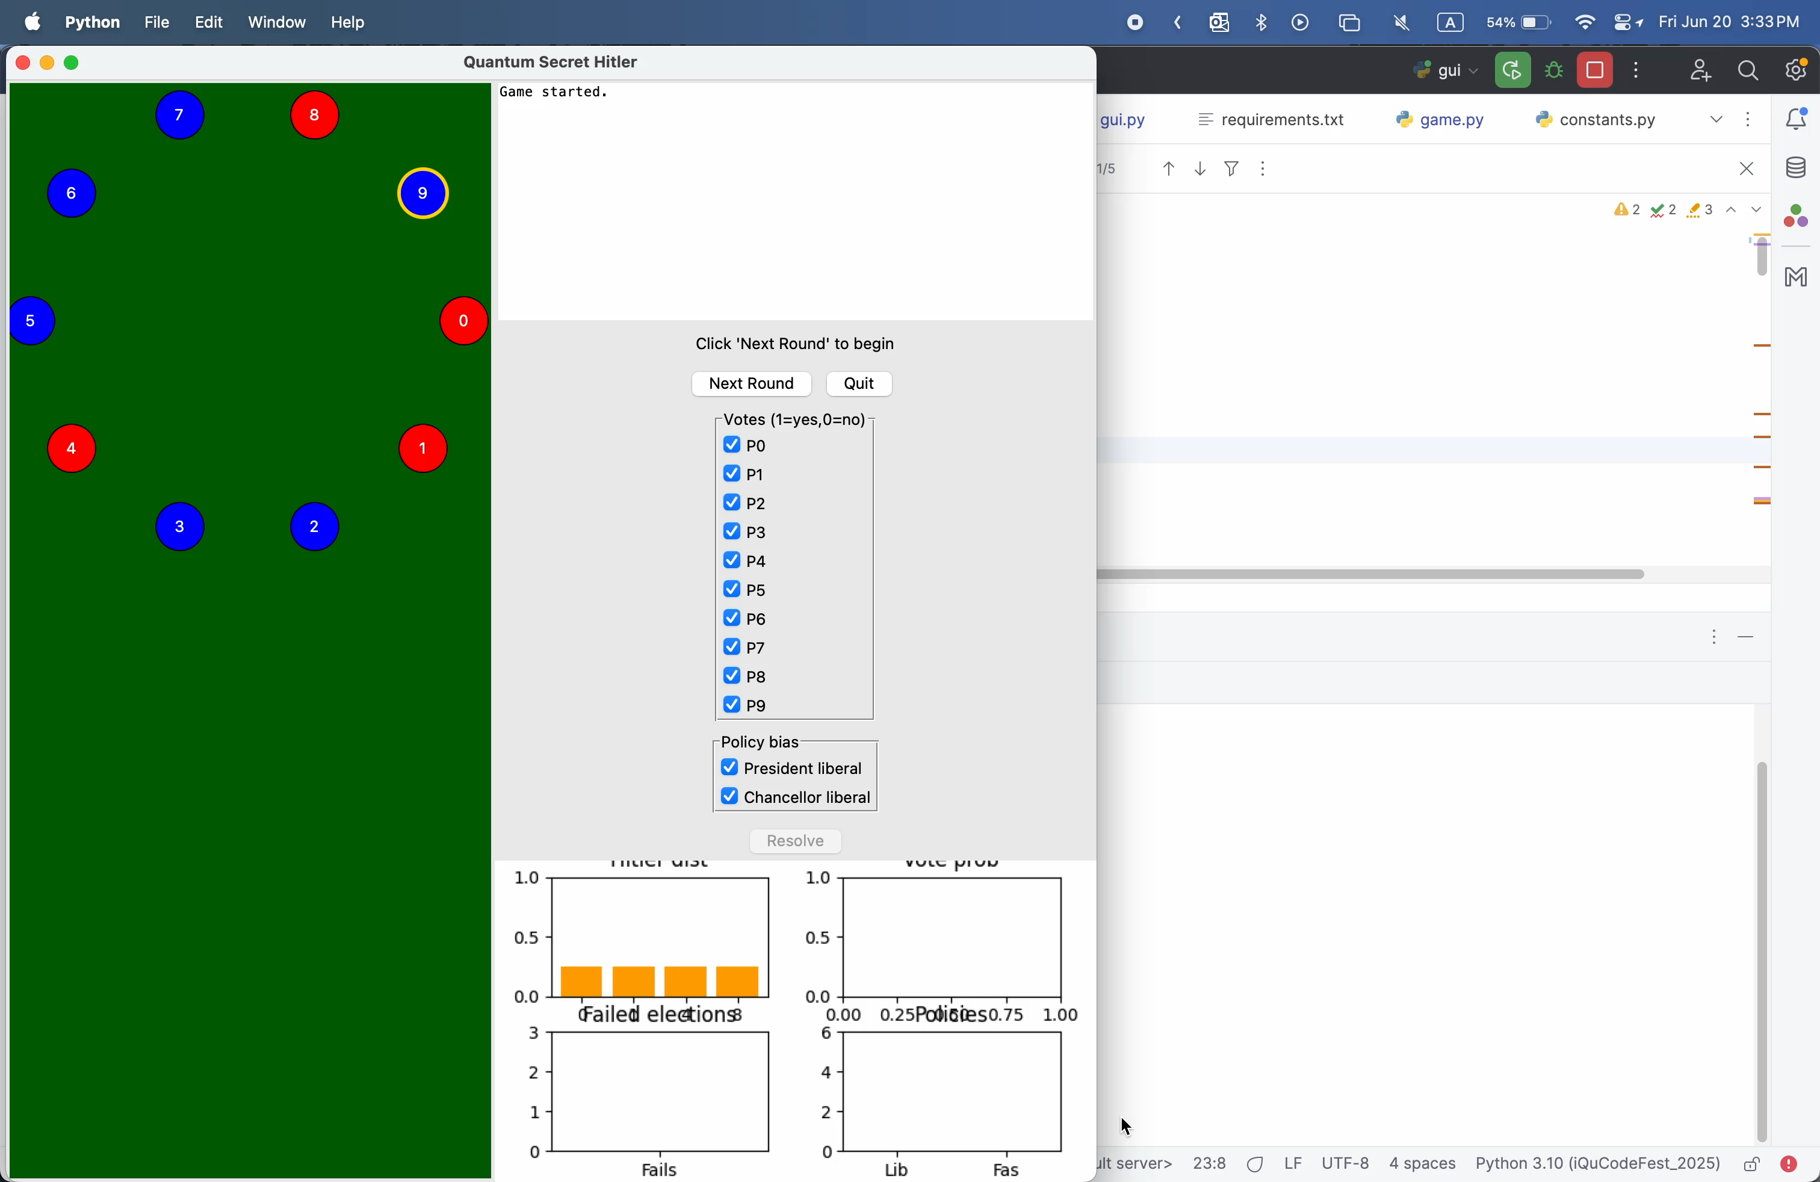
Quick demo

Slide 11
Thanks for the hackathon!
(Thanks ChatGPT for heavily helping with the code)

